Slide 1
A novel method to study heat transfer enhancement and cooling
Connor Moreno
Institution: Northern Arizona University
Mentor: Dr. Amir Arzani

Slide 2
Introduction
Heat transfer (HT) in engineering
HT important for many devices
Power plants
Automobiles
Electronics

Slide 3
Introduction (Cont.)
HT modeling in engineering
Simulations necessary in design
Traditionally done using advection-diffusion (A-D) equations
Accurate but slow
High-resolution simulations take 10+ hours: downtime
Room for improvement

Slide 4
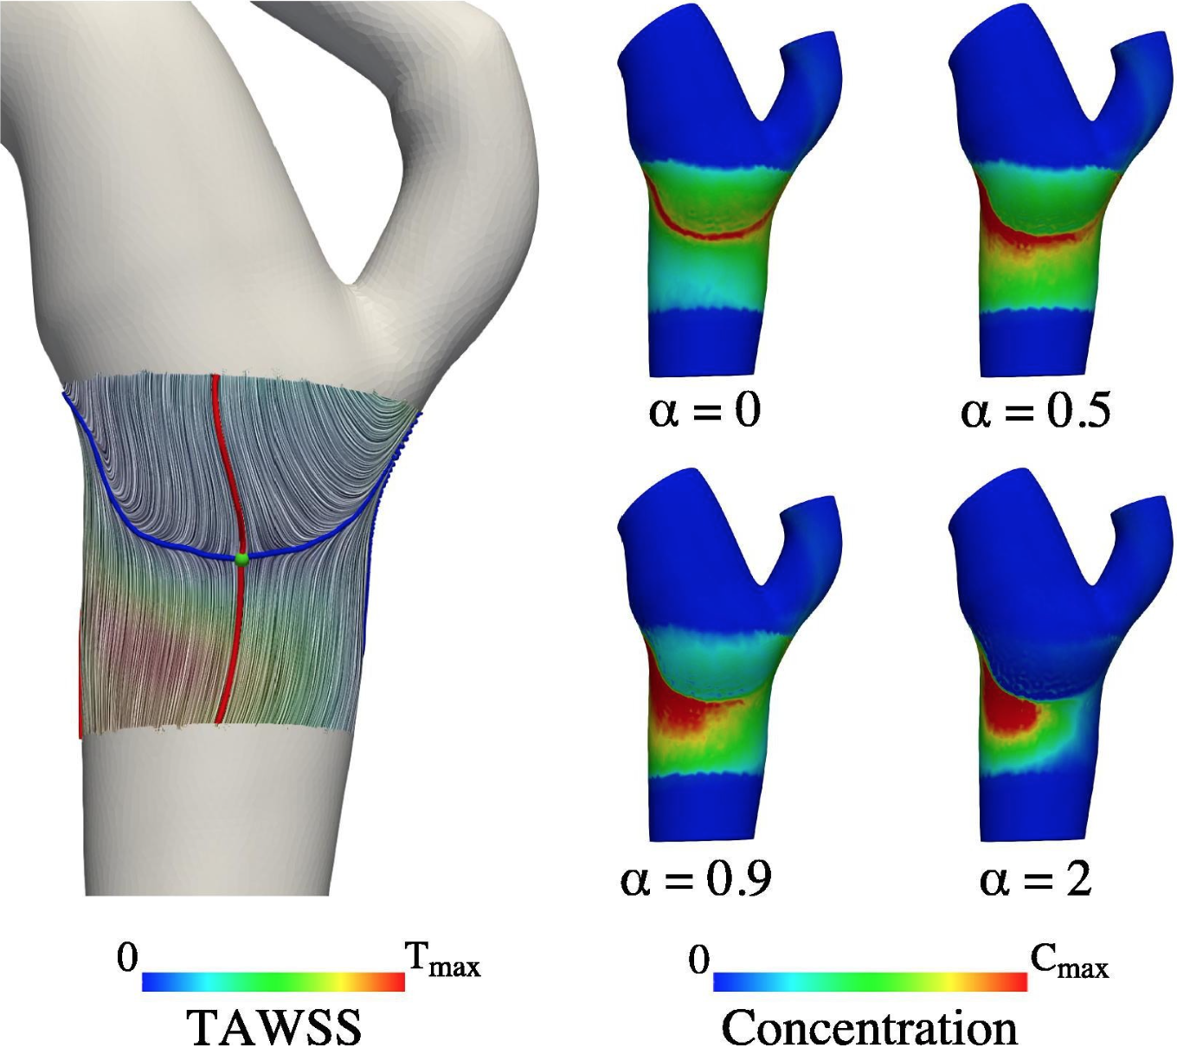
Introduction (Cont.)
Novel technique
Created by Dr. Amir Arzani through discovery in cardiovascular mass transport settings
Correlation between two parameters
Near wall flow: attractors
Surface concentration (advection-diffusion)
Attractor (blue) and corresponding surface concentration with varying surface mass flux uniformity (α)

Slide 5
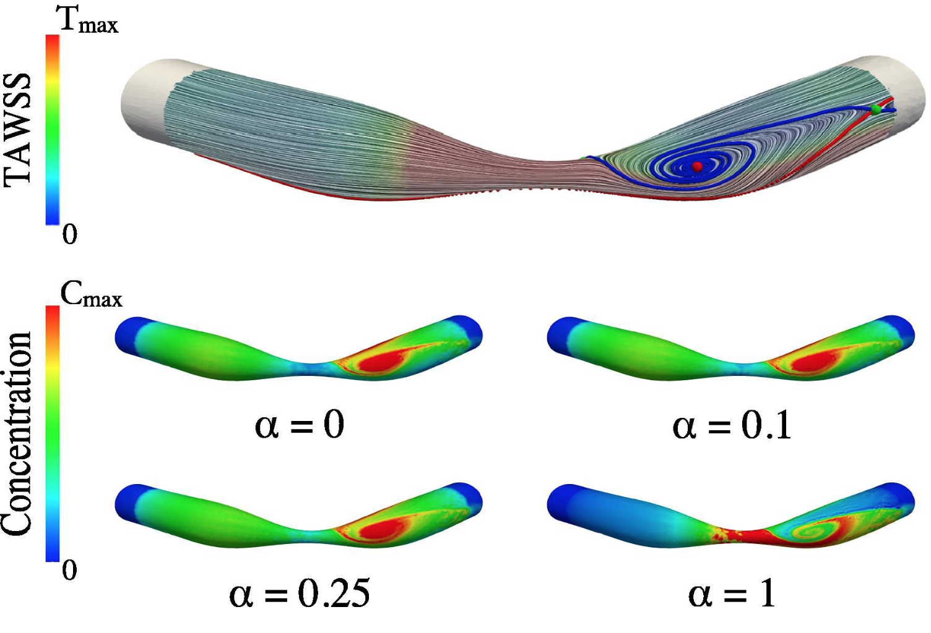
Introduction (Cont.)
Novel technique (cont.)
Good estimation of patterns
Sacrifice accuracy for time
Surface concentration – surface temperature
Desire to apply to HT
Attractor (blue) and corresponding surface concentration with varying surface mass flux uniformity (α)

Slide 6
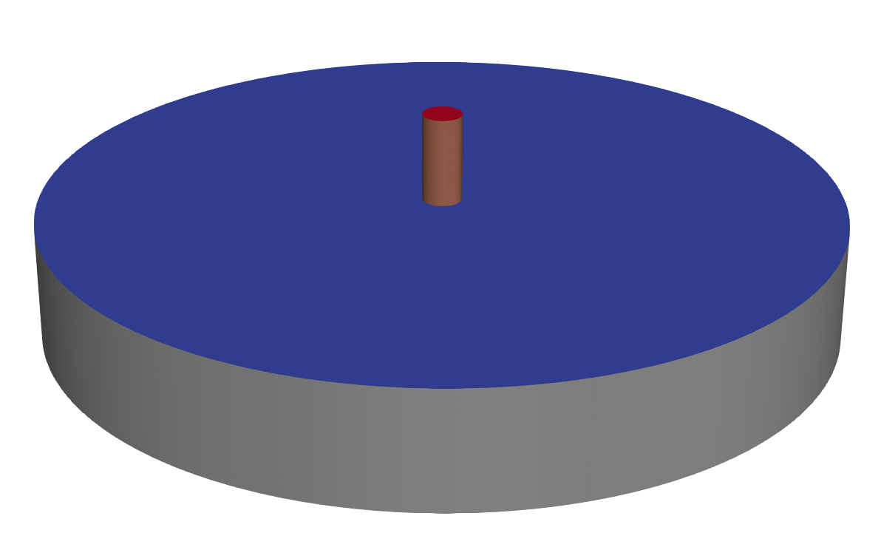
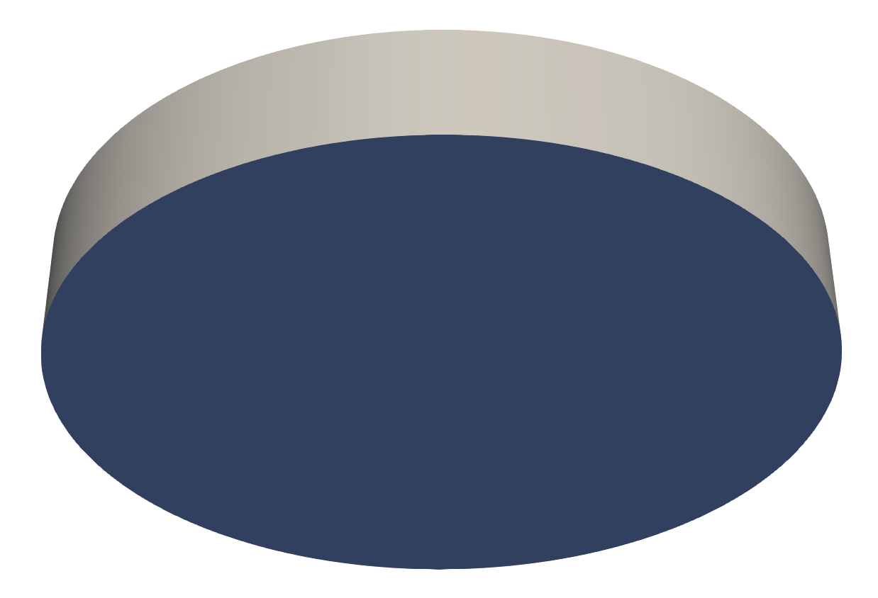
Methods
Classical impinging jet
Region of interest: bottom plate
Computational fluid dynamics – finite element method
Navier-Stokes: Oasis
Advection-Diffusion: FEniCS
(a)
(b)
(a): impinging jet configuration
(b): bottom plate (region of interest)

Slide 7
Data
(a)
(b)
(c)
(a): fluid flow velocity magnitude (mm/s)
(b): WSS magnitude (mPa) demonstrating near wall flow
(c): surface temperature (°C)

Slide 8
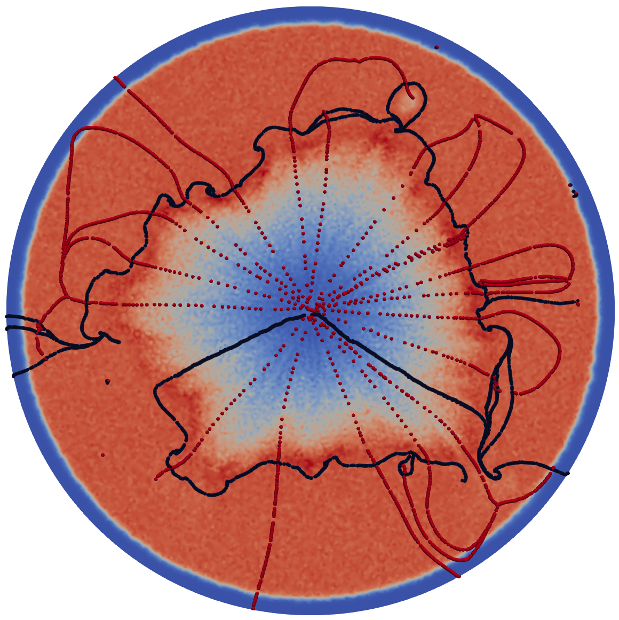
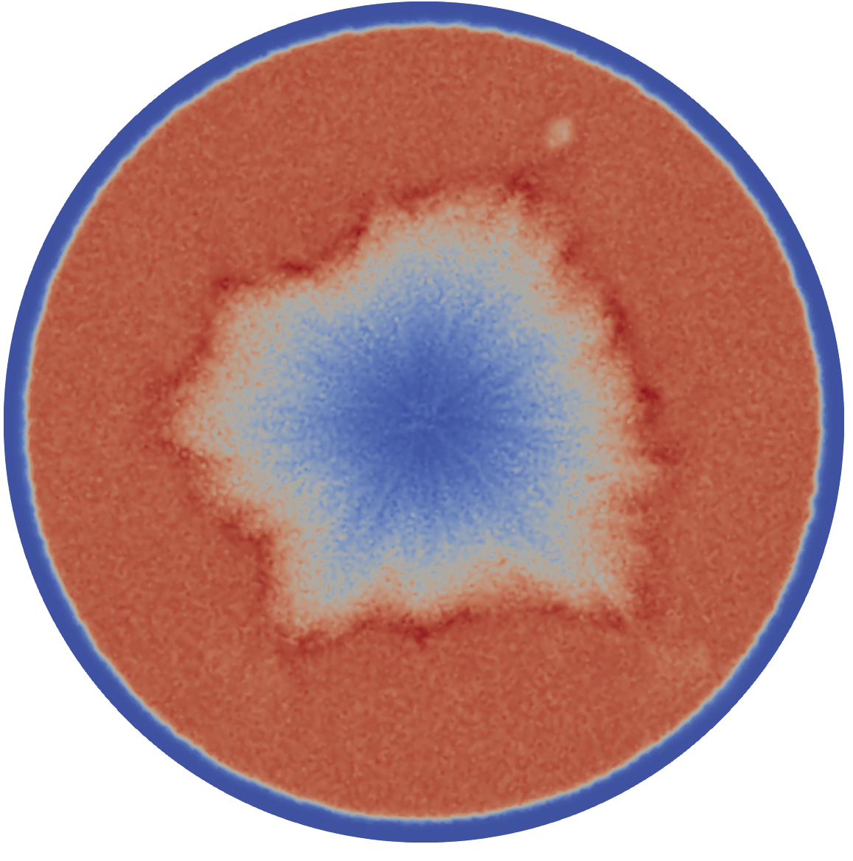
Analysis
(a)
(b)
(c)
(a): attractors and time-averaged near-wall flow
(b): attractors and time-averaged surface temperature
(c): time-averaged surface temperature

Slide 9
Data
(a)
(b)
(c)
(a): fluid flow velocity magnitude (mm/s)
(b): WSS magnitude (mPa) demonstrating near wall flow
(c): surface temperature (°C)

Slide 10
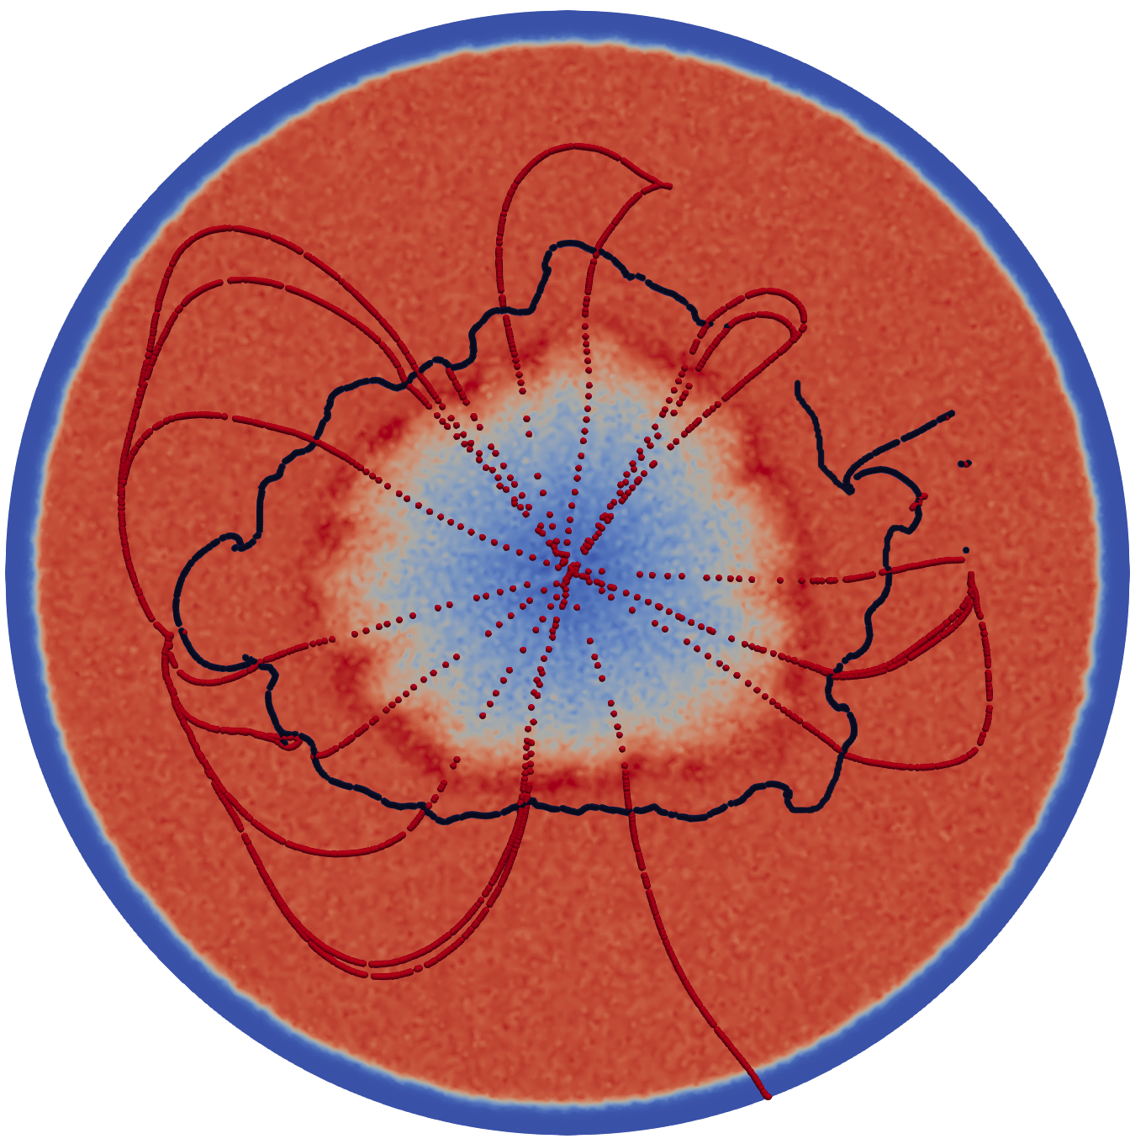
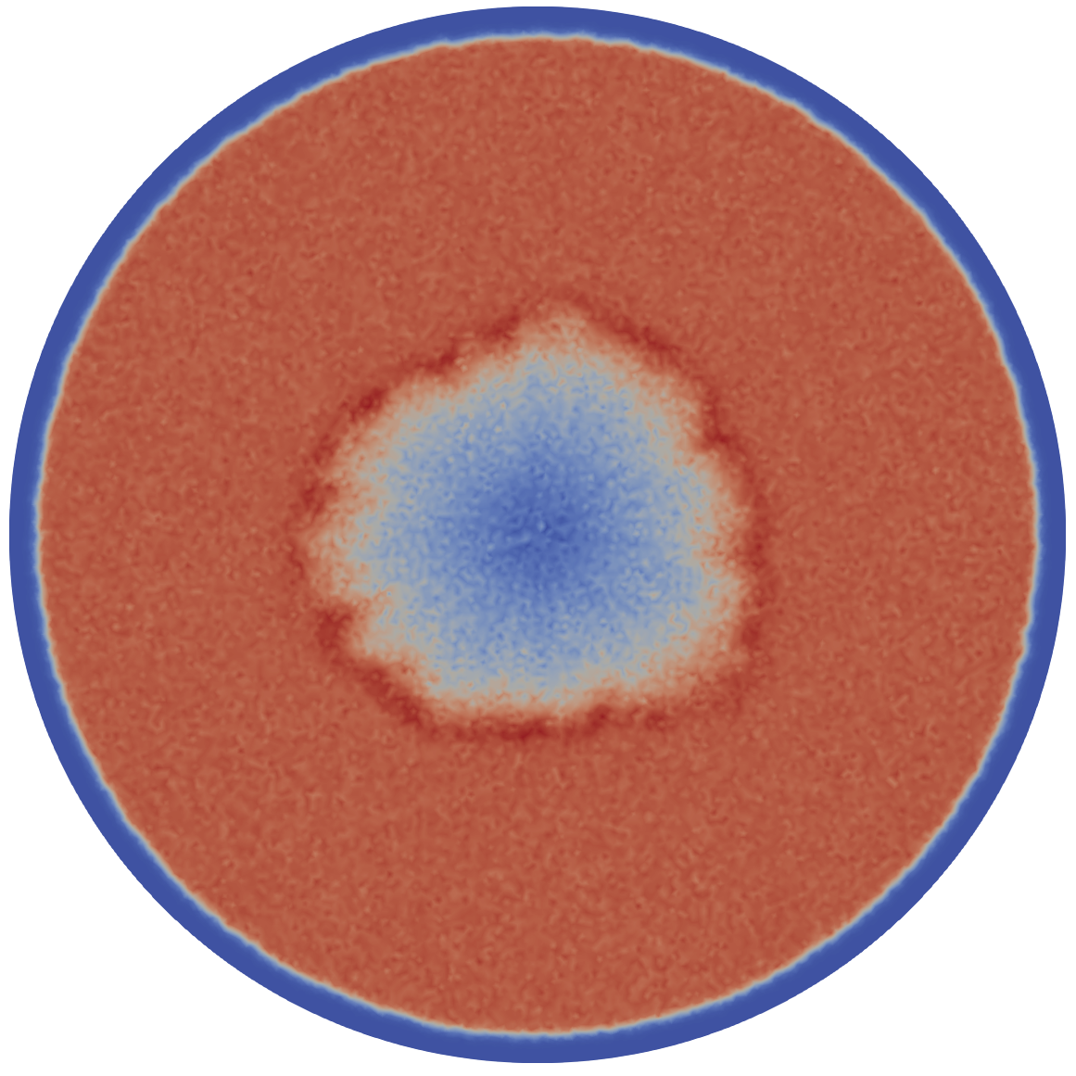
Analysis
(a)
(b)
(c)
(a): attractors and near-wall flow
(b): attractors and time-averaged surface temperature
(c): time-averaged surface temperature

Slide 11
Conclusion
Performance
Excellent for moderate complexity
Accuracy decreases as complexity increases
Use
Simple case
Used with advection-diffusion
Future work
More complicated applications

Slide 12
Acknowledgements
NASA Space Grant
Dr. Nadine Barlow
Kathleen Stigmon
Dr. Amir Arzani
NAU Cardiovascular Biomechanics Lab
NAU High Performance Computing

Slide 13
Any Questions?

